Slide 1
Customer Churn Prediction – Key Findings & Suggestions
TARGET THE RECENT CLIENTS WITH DISCOUNTS
It is seen that the churn percent of recent clients, whose tenure began in the last five years is much higher compared to the older clients. This is the case except for clients whose tenure starts in 2015 (final year)
TRY TO GET THE CLIENTS SUBSCRIBED TO MULTIPLE PRODUCTS
Clients who have more than 5 active product subscriptions have a churn rate of zero.
TARGET CLIENTS WHO HAVE HIGH POWER MARGIN WITH DISCOUNT
There is a strong dependency of churn with the power margins (gross & net) on a client. Hence, those customers who are currently giving a high profit should be considered for some discounts.

Slide 2
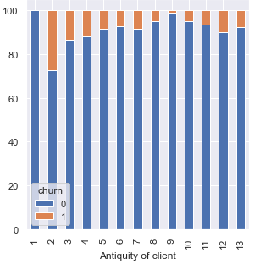
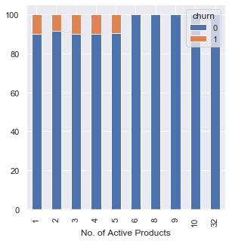
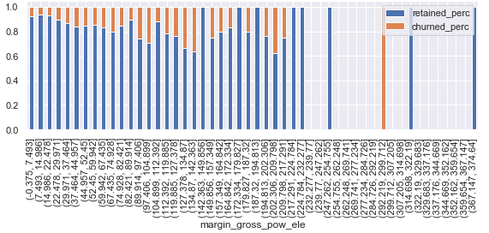
Supporting Graphs
Stacked bar plot of Antiquity of Client
Stacked bar plot of No of Active Products
Percentage stacked histogram – Gross Power Margin

